Slide 1
TCP拥塞控制机制

Slide 2
TCP Congestion Control
Challenge
determining the available capacity in the first place (Without additional protocols or APIs)
adjusting to changes in the available capacity (Adjustments must be made quickly since a large window may already be out on the network)
Implementation
increase CongestionWindow when congestion goes down (slowly)
decrease CongestionWindow when congestion goes up (quickly)
Question: how does the source determine whether or not the network is congested?

Slide 3
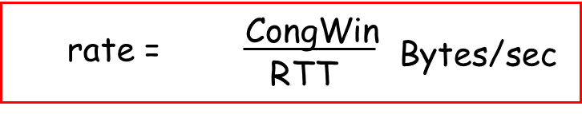
TCP Congestion Control: details
sender limits transmission:
LastByteSent-LastByteAcked
≤ CongWin
Roughly,
CongWin is dynamic, function of perceived network congestion
How does sender perceive congestion?
loss event = timeout or 3 duplicate acks
TCP sender reduces rate (CongWin) after loss event
three mechanisms:
AIMD
slow start
conservative after timeout events

Slide 4
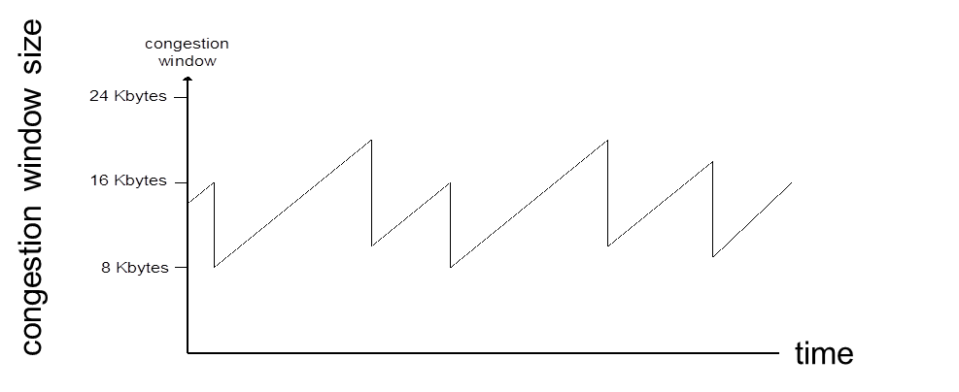
TCP congestion control: additive increase, multiplicative decrease
Approach: increase transmission rate (window size), probing for usable bandwidth, until loss occurs
additive increase: increase CongWin (congestion window) by 1 MSS (Maximum Segment Size ) every RTT until loss detected MSS=MTU-IP-TCP
multiplicative decrease: cut CongWin in half after loss
Saw tooth
behavior: probing
for bandwidth

Slide 5
TCP Slow Start
When connection begins, CongWin = 1 MSS
Example: MSS = 500 bytes & RTT = 200 msec
initial rate = 20 kbps
available bandwidth may be >> MSS/RTT
desirable to quickly ramp up to respectable rate
When connection begins, increase rate exponentially fast until first loss event

Slide 6
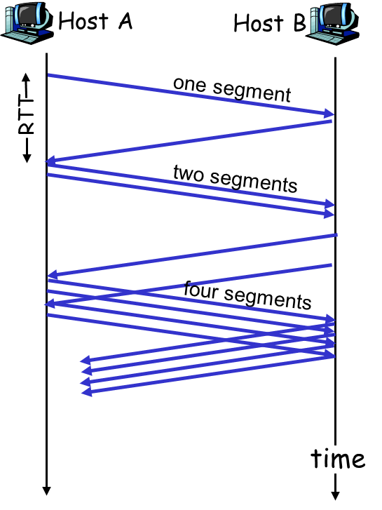
TCP Slow Start (more)
When connection begins, increase rate exponentially until first loss event:
double CongWin every RTT
done by incrementing CongWin for every ACK received
Summary: initial rate is slow but ramps up exponentially fast

Slide 7
Refinement: inferring loss
After 3 dup ACKs:
CongWin is cut in half
window then grows linearly
But after timeout event:
CongWin instead set to 1 MSS;
window then grows exponentially
to a threshold, then grows linearly
Philosophy:
3 dup ACKs indicates network capable of delivering some segments
timeout indicates a “more alarming” congestion scenario

Slide 8
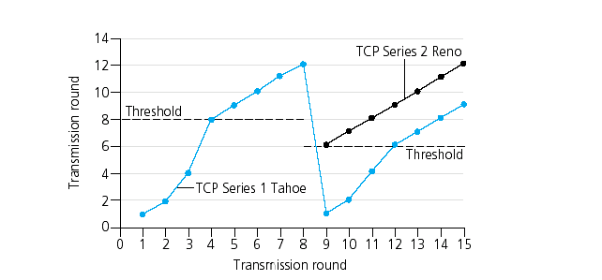
Refinement
Q: When should the exponential increase switch to linear?
A: When CongWin gets to 1/2 of its value before timeout.
Implementation:
Variable Threshold
At loss event, Threshold is set to 1/2 of CongWin just before loss event

Slide 9
TCP Congestion Control
When CongWin is below Threshold, sender in slow-start phase, window grows exponentially.
When CongWin is above Threshold, sender is in congestion-avoidance phase, window grows linearly.
When a triple duplicate ACK occurs, Threshold set to CongWin/2 and CongWin set to Threshold.
When timeout occurs, Threshold set to CongWin/2 and CongWin is set to 1 MSS.

Slide 10
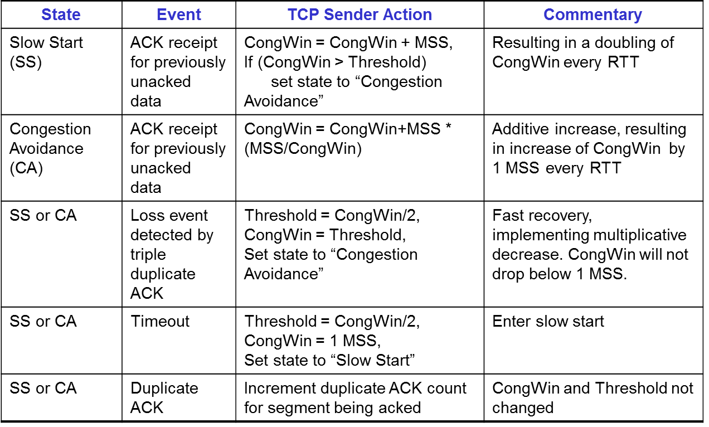
TCP sender congestion control

Slide 11
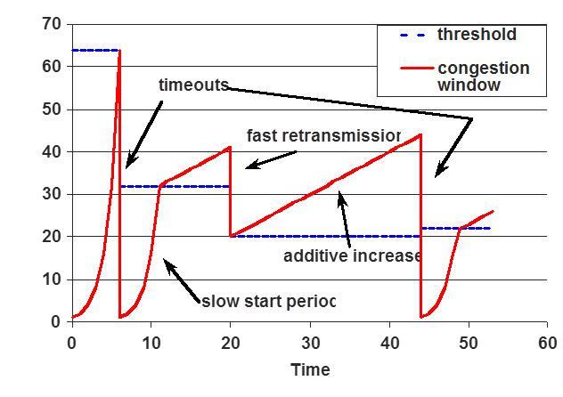
TCP Congestion Window Trace

Slide 12

Summary
Principles of TCP congestion control
Congestion window adjustment

